Slide 1
Modeling March Madness with Python
Follow along at:
github.com/nicholas-vogt/modeling-march-madness
Notes:
Open these links for easy access during presentation:
http://www.sports-reference.com/cbb/boxscores/index.cgi?month=02&day=03&year=2017
Keep in mind:
Speak slowly and clearly.
Keep people involved.

Slide 2
Who am I? Nick Vogt
B.S. Economics & Computational Mathematics
Vice President, Co-Founder, MSU Data Science
Python Enthusiast
Sports Fanatic
Future Data Scientist at Ford

Slide 3
Part One of a Four Part Series!
Required Knowledge:
Beginner Knowledge of Python 3
A Healthy Interest in Statistics and Machine Learning
Web Scraping
Data Mining
Choosing a Model
Model Evaluation
I will share each presentation at facebook.com/MSUDataScience
Notes:
Today, we’ll only need to know about Python

Slide 4
How to Participate
Find the repo at
github.com/nicholas-vogt/modeling-march-madness
Watch and follow along with the jupyter notebooks (.ipynb)

Slide 5
Part 3 of 4: Choosing a Model

Slide 6
What is a Model?
A model infers new information from existing data.
Supervised Model
Infers information with prior examples.
e.g. Most statistical models, Random Forests
Unsupervised Models
Infers information with no prior examples.
e.g. K-means classification
Reinforcement Models
Infers information and receives feedback on quality of answers.
e.g. Q-learning
Notes:
Farmer Analogy
If you have no food, you have some options:
Use Open Data (go to McDonald’s)
Collect your own data (start a garden)
Scrape the data (go grocery shopping)

Slide 7
What you can expect
Examples with pandas, statsmodels.
How to choose a model (hence the namesake)
Common feature engineering techniques.
Lags, cumsums, interactions, log-transformations.
Designated question slides after each section.
What else do you hope to learn?
Notes:
No time for matplotlib

Slide 8

What’s Ahead
Organizing Datasets
Merging Datasets
Logit and Random Forests Models
Feature Engineering with pandas
Fitting the Model
Program Architecture

Slide 9
Organizing Datasets
The metaphorical and literal key to your data

Slide 10
Organizing Datasets
Every dataset has a key linking it to another dataset.
Keys save space.
e.g. Integers are more efficient to store than Unicode strings.
In my examples, I’ve kept the string variables to view the data easier.
ID Files for Teams, Games, and Matchups
Matchups refer to possible NCAA tournament matchups.

Slide 11
Examples
Game Data
Game IDs
GameID | TeamID | FG | FGA
10000 | 1001 | 33 | 57
10000 | 1090 | 28 | 60
10001 | 1289 | 33 | 55
10001 | 1094 | 32 | 51
10002 | 1118 | 28 | 60
10002 | 1017 | 29 | 55
GameID | Date | TeamID
10000 | 2017-01-01 | 1001
10000 | 2017-01-01 | 1090
10001 | 2017-01-01 | 1289
Team IDs
TeamID | TeamName
1000 | Abilene Christian
1001 | Air Force
1002 | Akron

Slide 12
Merging Datasets
Pandas has a `merge` function for this purpose.

Slide 13
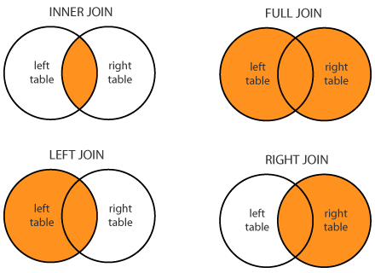
Types of Joins
http://www.dofactory.com/Images/sql-joins.png

Slide 14
Random Forests Classifier
The Perennial Machine Learning Algorithm

Slide 15
Random Forests
How does it work?
Builds 1000s of trees on several subsets of the data.
Why does it work?
What is a tree?
An if-then decision tree goes through

Slide 16
Random Forests
If (FGpct > 40)
If (FTpct > 80)
Lose
Win
If (PF < 5)
Win
Lose

Slide 17
Logistic Regression a.k.a. The Logit Model
Before machine learning was cool.

Slide 18
Logistic (Logit) Regression
Notes:
Hypertext: Think “hyperlink.” Hypertext facilitates linking topics within text.
HTML is structured data

Slide 19
Feature Engineering
Lag variables
Commonly used in time series models.
Rolling and cumulative summations
Running total of season statistics.
Interaction variables
Useful when combined variables yield different, unique behavior.
Log-transformed variables
Useful for modeling diminishing returns.

Slide 20
Fitting the Model

